Slide 1
RUNTIME VERIFICATION FOR SPATIO-TEMPORAL PROPERTIES OVER IOT NETWORKS
Second partial release of the project
DEGREE IN COMPUTER ENGINEERING
Oihana Garcia Anakabe
2021/2022

Slide 2
Index
Introduction
State of the art
Development
Problems and solutions
Work done until now

Slide 3
Introduction
Description
Objectives
Product requirements

Slide 4
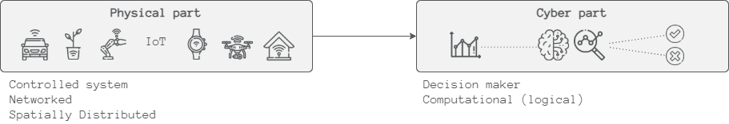
Description
CPS (Cyber Physical Systems) is one of the systems that can exploit an IoT infrastructure
IoT is a field that is growing fast (2030 → 25,44 billion worldwide connected devices)
In CPS physical systems are monitored and/or controlled by a computational core
Monitoring is an activity related to the wider category of Runtime Verification (RV)
The increasing numbers of IoT devices and intelligent systems made CPS influence society
Notes:
Monitoring is an activity related to the wider category of Runtime Verification (RV), which purpose is to observe information from a system while it is operating and analyse the behaviour to detect if it satisfies or violates certain properties.
Monitoring the status of a CPS at runtime can give precise information to ensure reliability, safety, robustness and security
The increasing numbers of IoT devices and intelligent systems made CPS influence society:
Self-driving cars
Home equipment
Medical devices

Slide 5
Objectives
This project focuses precisely on the challenges when doing monitoring on CPS over IoT.
Feed MoonLight monitor with live data
Implement a middleware that offers different services
Establish the communication between the sensors and the monitor
Adapt the received data to the monitor
Show the results to the user
Notes:
The objective of this project is to feed MoonLight (the provided monitor) with live data. Moonlight previously has been tested with a Matlab interface since this tool has several CPS models and analysis tools available [7]. With that being said, this is the first time for the monitor to receive real data, so the purpose of this project is to help MoonLight be able to monitor different use cases and see how it works with actual real time data.

Slide 6
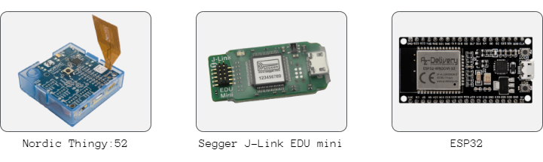
Product requirements
Software
Hardware
Moonlight
Zephyr and Arduino
Thingsboard

Slide 7
State of the art
Cyber Physical Systems
Monitor
Communication

Slide 8
Cyber Physical Systems
CPS plays an important role in Industry 4.0.
“Now a Fourth Industrial Revolution is building on the Third, the digital revolution that has been occurring since the middle of the last century. It is characterized by a fusion of technologies that is blurring the lines between the physical, digital, and biological spheres.”
Klaus Schwab (WEF)
The mechanical systems on their own are not relevant anymore, that is why CPS is widely applied in various fields.
CPS can learn from the physical world and in some cases even interact with the world, turning environments into Smart Environments

Slide 9
Monitor
Monitoring is an activity to observe systems behaviour, and enabling the runtime verification (RV) techniques, monitors can track systems while they are operating.
Moonlight
Online monitor
Most specification languages and tools available for CPS supports only the monitoring of temporal properties.
The monitors should include a language to specify the requirements needed to monitor the system efficiently. STREL can fulfil temporal information but also spatial needs

Slide 10
Communication
BLE: Bluetooth Low Energy (BLE) is one of the most widely applicable low-power connectivity standards.
MQTT: This is a standard messaging protocol widely used for the Internet of Things. It is ideal for connecting remote devices with low computational power and a minimal network bandwidth. It is designed as an extremely lightweight publish/subscribe messaging transport and thanks to this, it has become one of the most used IoT protocols
WiFi: It allows all kind of different devices to interface with the Internet.

Slide 11
Development
Moonlight
Middleware
SOA
Physical system

Slide 12
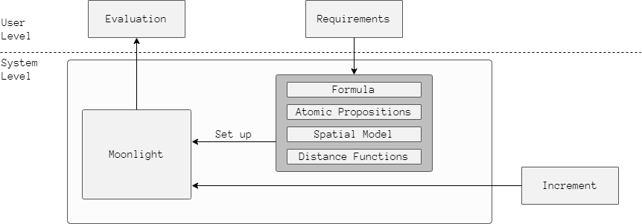
Moonlight
Online
Data conversión

Slide 13
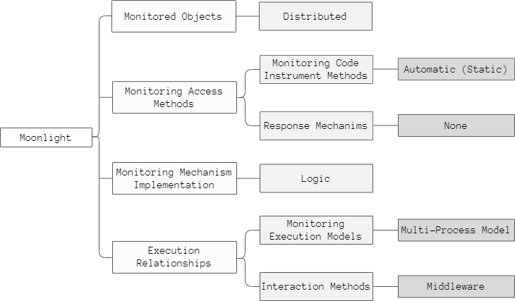
Moonlight

Slide 14
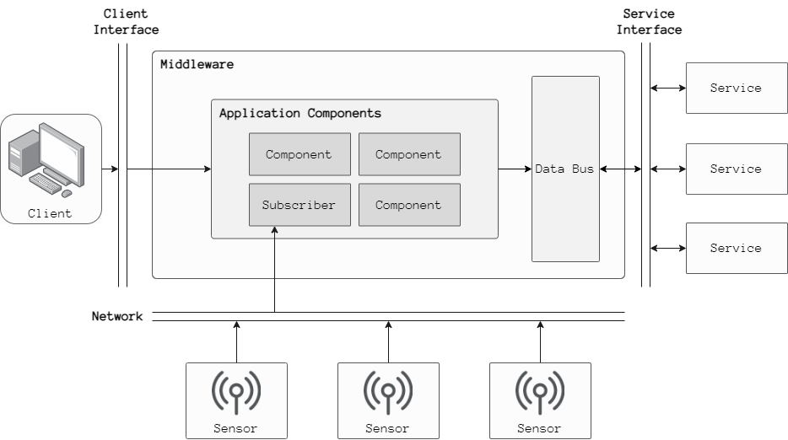
Middleware

Slide 15
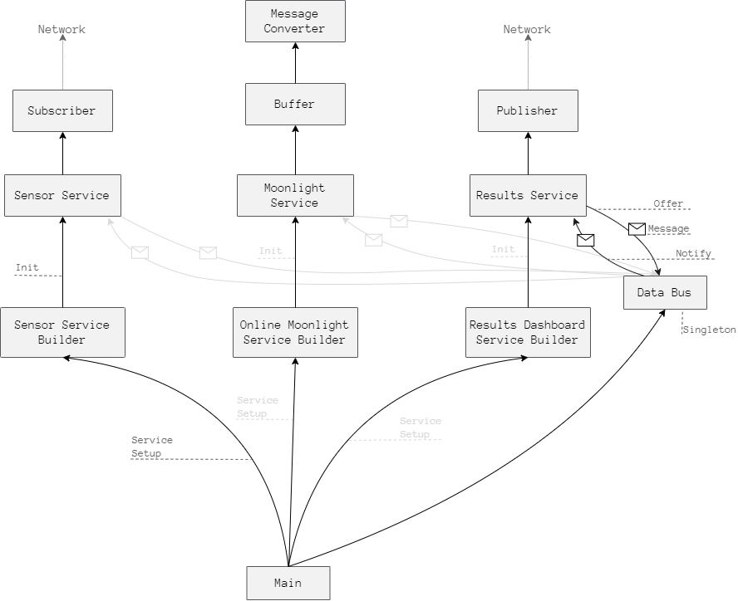
SOA

Slide 16
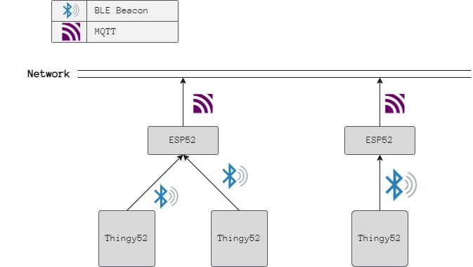
Physical system
a

Slide 17
Problems and solutions
Sensors time synchronization
Missing values and imprecise signals
Other problems

Slide 18
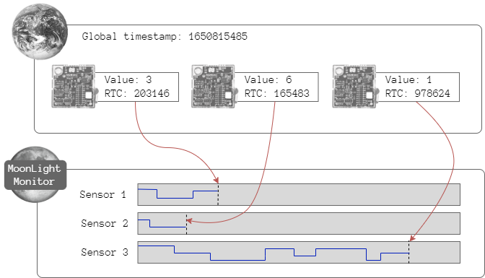
Sensors time synchronization
Problem
Solution
Time List
203146
165483
97624

Slide 19
Missing values and imprecise signals
MoonlightRecord had some problems: Escape + online monitor + MoonlightRecord = infinite loop
The null values didn’t throw errors, wrong error handling

Slide 20
Other problems
MoonlightRecord had some problems: Escape + online monitor + MoonlightRecord = infinite loop
The null values didn’t throw errors, wrong error handling
I was having problems with Windows + Zephyr project

Slide 21
Work done until now
Use case
Results

Slide 22
Use case
Office use case

Slide 23
Results

Slide 24
Results

Slide 25
Thank you
Eskerrik asko

